Slide 1
Everyone deserves respect ___________________________________.不管是性别还是职业
Her main occupation seems to be shopping.
The area is _________________. 被占领
When the first scientists came to the region they found little evidence of human occupation.
第一批科学家来到这个地区时，他们基本没发现任何人类居住过的痕迹。（居住，使用）
occupational disease 职业病
occupy (take up)
She is fully ______ ______ work.
I kept the kids occupied by reading them a book.
occupant —resident
Hotel occupancy has been as low as 40%.
regardless of the gender and occupation
pastime
under occupation
occupied with
Notes:
我靠给孩子们读书吸引他们的注意力
酒店入住率最低达到 40％

Slide 2
This training course will qualify you ____ a better job.
qualify sb to do sth
He qualified ____ a doctor last year.
他去年获得了医生的资格。
These guides are ________ to lead groups.
have the right ___________ to do sth.
质量高 be _____ high _______
for
as
qualified
qualifications
of quality

Slide 3
There is little prospect of any improvement in the weather.
1) possibility
There is every prospect of sth/doing sth.
Major developments are in prospect for the company. (coming soon)
2) chances of success
Job/Employment/Career prospects for graduates do not look good.
an industry with good prospects
= a __________ industry
3) vision or an idea
She wasn’t overjoyed at the prospect of looking after her niece.
a ___________ candidate 可能成功的候选人
a prospective buyer/client
He had prospected for minerals everywhere from the Gobi Desert to the Transvaal.
promising
prospective
Notes:
做某事极有希望
The prospect of sth
有望……
前景
潜在的客户
勘探 oil prospecting

Slide 4
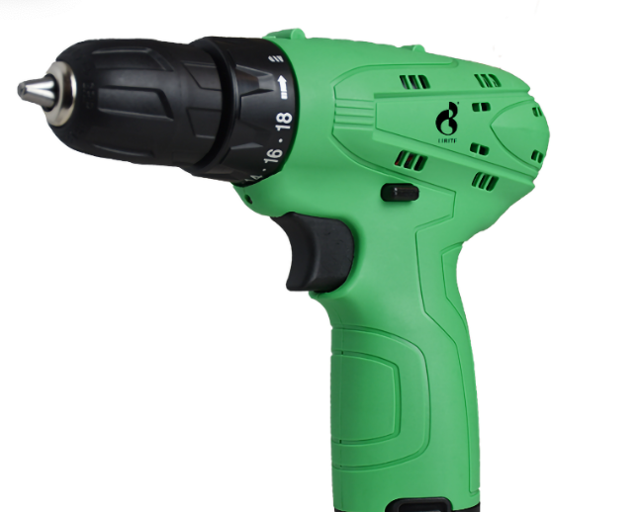
an electric drill
There have been proposals to drill for more oil.
do/practise/go through a fire drill
The children were drilled to leave the classroom quickly 当火警铃拉响时 _________________________.
训练某人做某事 drill sb to do sth
teach by stimulation rather than repetitive drilling
pronunciation/grammar drills
What's the drill for filling in time sheets?
procedure 正确的步骤
when the fire bell/alarm rang
Notes:
有人提议钻探更多的石油。
I drilled five holes at equal distance.[VERB noun]
我钻了 5 个等间距的孔。
激励而不是重复性操练

Slide 5
I have gained a high level of competence _____ English.
We've always regarded him as a man of integrity and high professional competence.
我们一直都认为他是个正直而且业务能力很强的人。
language/linguistic competence
have the competence to do sth 有做某事的能力
He was dismissed for ______________. 没能力
It is not ___________________ to make such judgements. 权限
He is very ________ ______ his work.
= be equal to
He is __________________________ the work.
incompetent
of
incompetence
within my competence
competent at
competent to carry out
Notes:
获得高水平的英语能力

